Slide 1
ELECTRONICS
WORKSHOP 2
SPRING 2023
UG 2
Heart monitoring circuit (ECG, Heart rate)
Team 16
Link to one drive folder:
https://iiitaphyd-my.sharepoint.com/:f:/g/personal/sannidhya_gupta_research_iiit_ac_in/EgJ9QPLAHIZBlJ_w_0Rzy9MBTH6wiUdICGOZ3w0bH5IflA?e=EknYz6
Sannidhya Gupta 2021112012
Vinkesh Bansal 2021102020

Slide 2
Understanding heart health: By displaying the heart rate, individuals can gain insights into their heart health and take necessary measures to improve it.
Educational purposes: This project can be a great learning tool for electronics enthusiasts who want to understand how to work with ECG signals.
Innovation: With the increasing demand for wearable technology, this project can be seen as a way to track heart rate and can be potentially added to the current range of wearable devices if refined with such motive.
Motivation

Slide 3
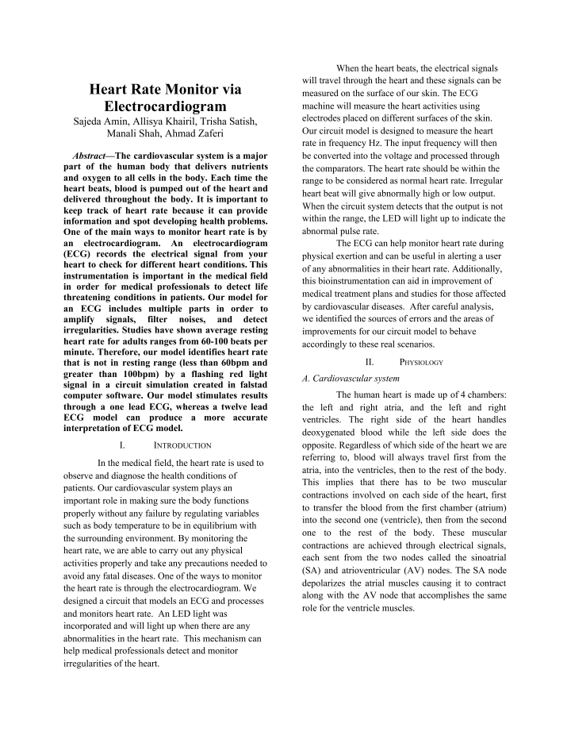
Literature Survey
We used the given paper to get a basic idea of how extraction of ECG works.
This paper discusses extraction and procsessing of ECG signal from the body by using 3 gel electrodes, and giving a LED output if the user's heartbeat lies outside the normal range
Link:
https://isn.ucsd.edu/courses/beng186b/project/2021/Amin_Khairil_Satish_Shah_Zaferi_Heart_rate_monitor_via_ecg.pdf

Slide 4
Introduction
Measuring ECG signal from the body
Processing the signal in order to make it informative
Analysing the signal frequency (heart rate)
Displaying the heart rate to the user

Slide 5
Execution blocks
ECG signal is extracted by gel electrodes
Amplfication
System to remove noise
Filters to remove unwanted bioelectronic signals
Clock
Display (Number of beats)
These are the subparts that we used for our circuit

Slide 6


Block Diagram
Extraction of signal using gel electrodes
Instrumentation amplifier
Filter (Low pass and High pass)
Narrow band Notch Filter
(50 Hz)
Display
(Using LEDs as binary bits)
Counter (using 4029 IC)
Analog to digital conversion
(555 timer)
Clock
(555 timer)

Slide 7
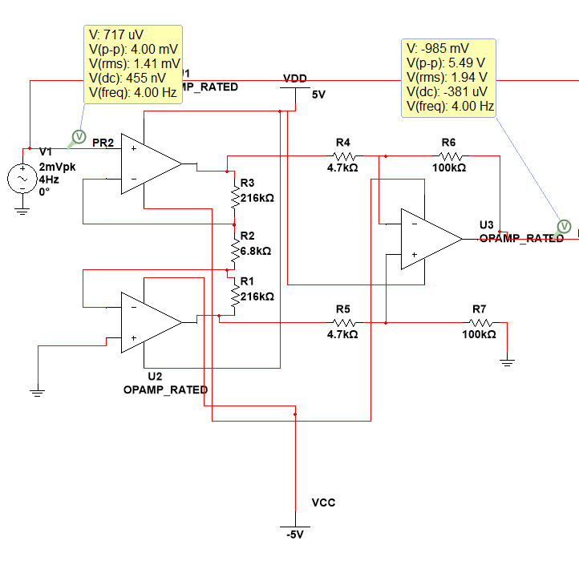
Instrumentation Amplifier
An instrumentation amplifier is an electronic device that is used to amplify small signals. It is a type of differential amplifier. The instrumentation amplifier is typically used in applications where the signal of interest is small and buried in a large amount of noise or other unwanted signals, such as in biomedical instrumentation

Slide 8
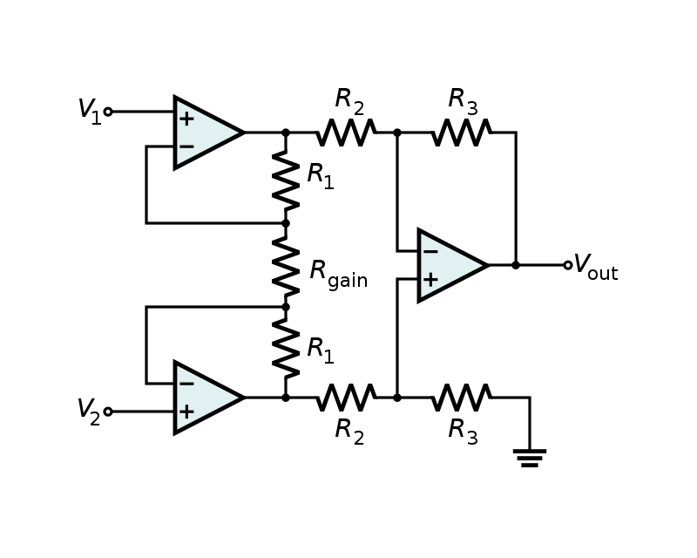
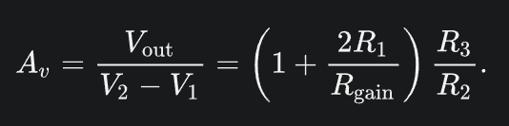
Gain analysis
Theoretical Gain =1,372.96

Slide 9
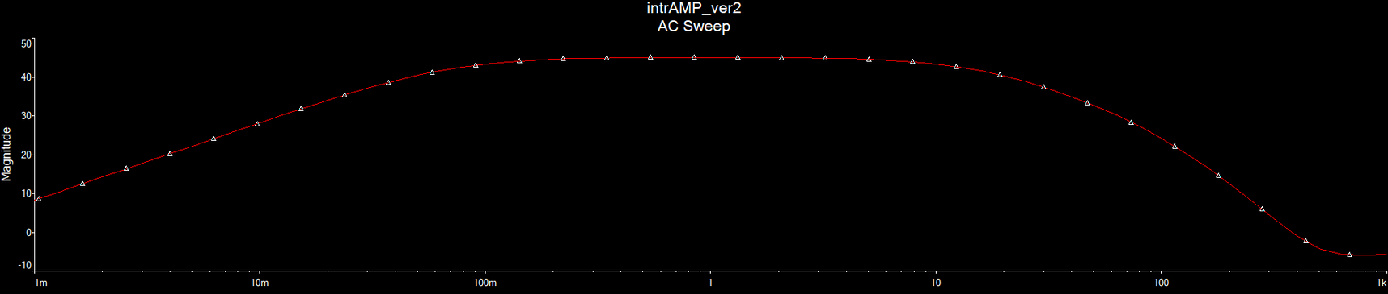
Low pass = 39.79Hz
High pass = 0.5Hz
Filters - Low and High Pass
As EMG and other signals lie outside this range
RC filters are used for this

Slide 10
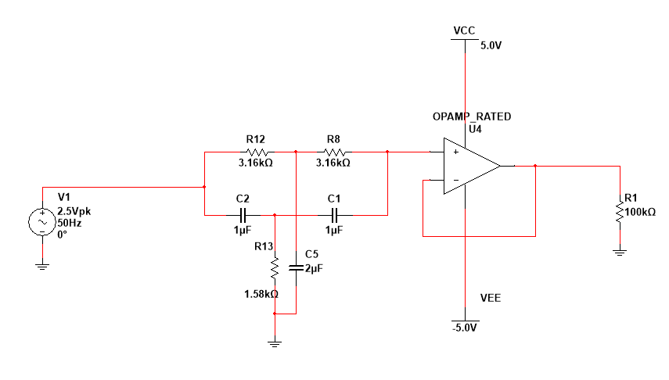
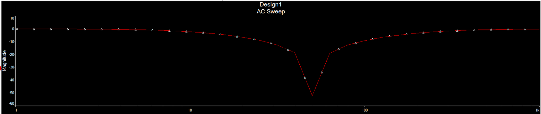
Notch Filter
A narrow band reject filter in order to reject the 50Hz noise present in the circuit

Slide 11
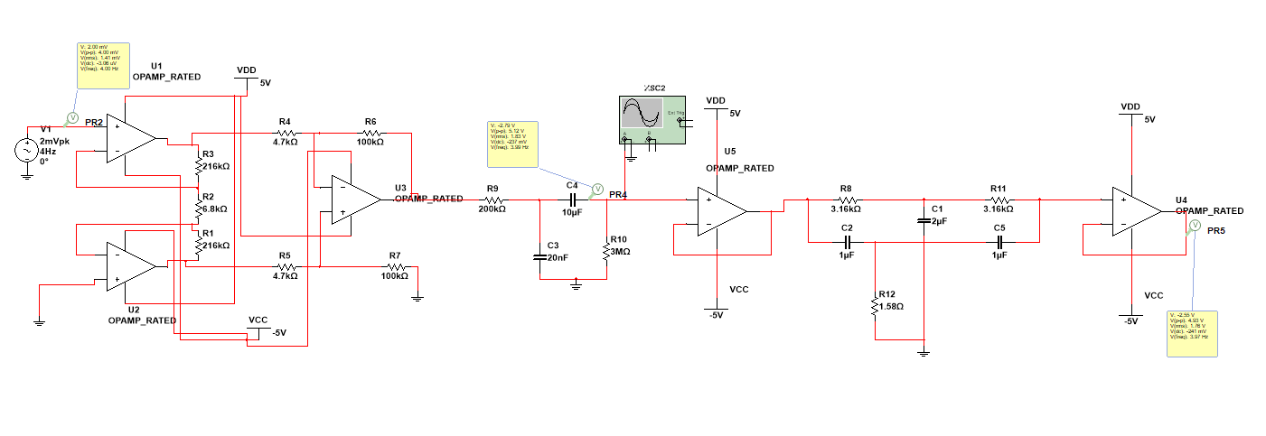
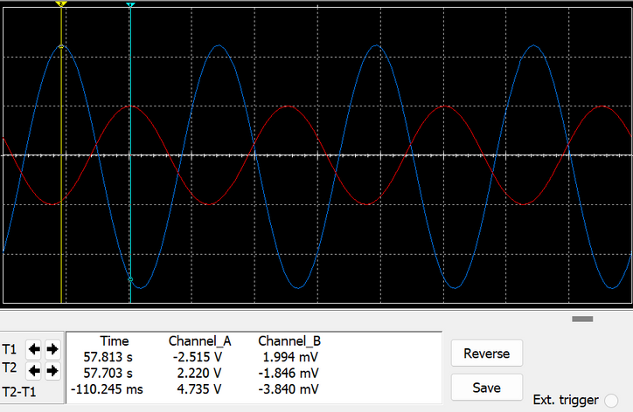
Final Simulation

Slide 12
Displaying the hearbeat
Display
(Using LEDs as binary bits)
Counter (using 4029 IC)
Analog to digital conversion
(555 timer)
ECG signal, obtained in pulses is first converted to square pulses, thus converting the hearbeat into digital domain
A clock of time period ~ 25 seconds is constructed
The digital signal is fed into counters after ANDing with the clock. Thus, the counter only counts when clock is on
Clock
(555 timer)

Slide 13
Important points
MIN MAX HEARTBEART MEASURABLE
0.7Hz to 5Hz
42bpm to 300bpm
The ECG has amplitude < 5mVpp, so circuit has been designed for 2mVpp
INPUT
RANGE
The square wave obtained as outputs have amplitude = Vcc
OUTPUT
RANGE

Slide 14
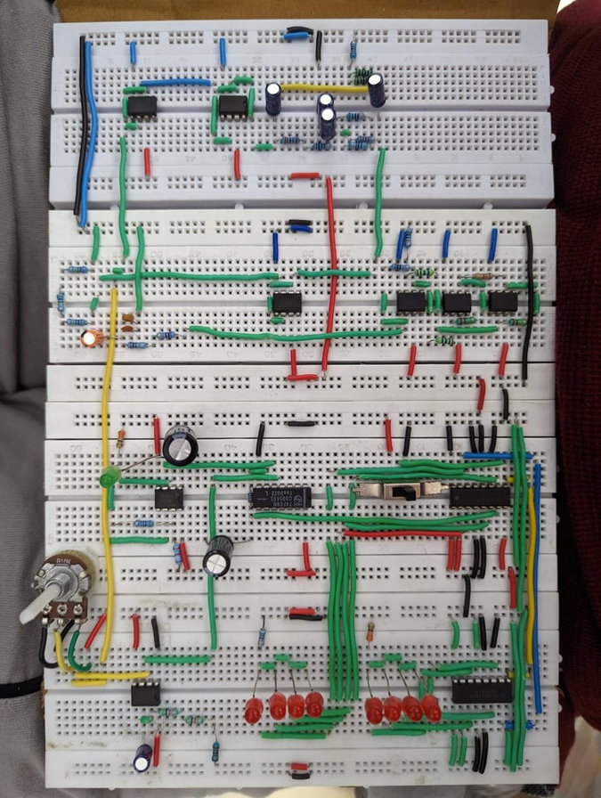
Hardware
The potentiometer adjusts our A/D converter by adjusting the required voltage for input signal
The green LED is the clock, it generates a high signal for T~25sec. The counter only counts when the clock signal is high
The 8 red LED's count the heart beats and display it in binary

Slide 15
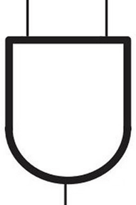
Counting system
input pulses (ECG signal from heart), rectified to be in the form of digital pulses
555 timer (clock generator)
T = 25 sec
AND
GATE
Asynchronous reset
(slide switch)
x 2
CD4029 IC:
4 bit binary counter
resets counter to zero
8 bit binary counter

Slide 16
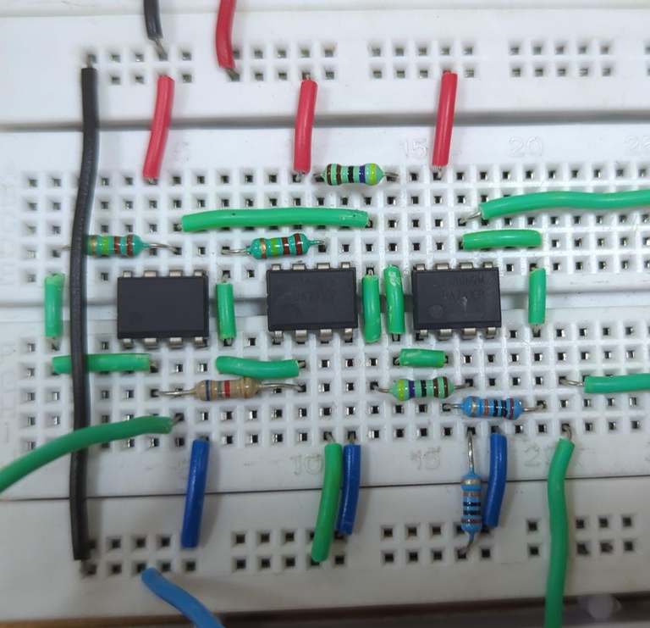
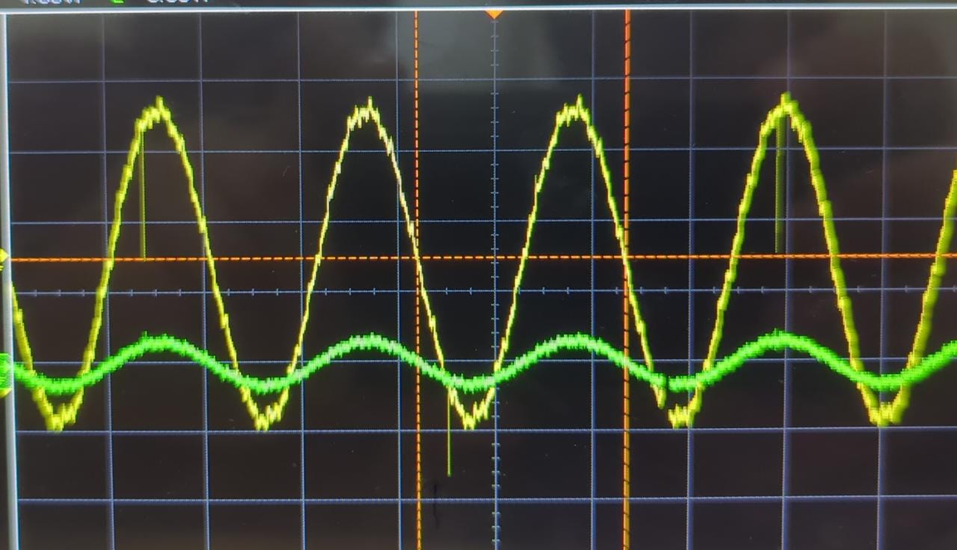
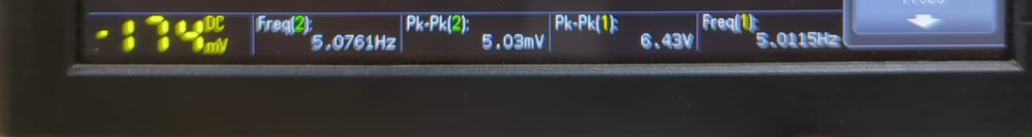
Amplifier
Observed Gain:
1278.36
Theoretical Gain =1,372.96

Slide 17
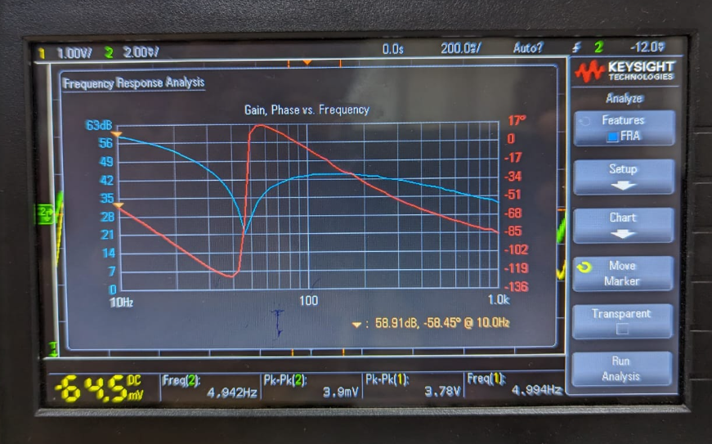
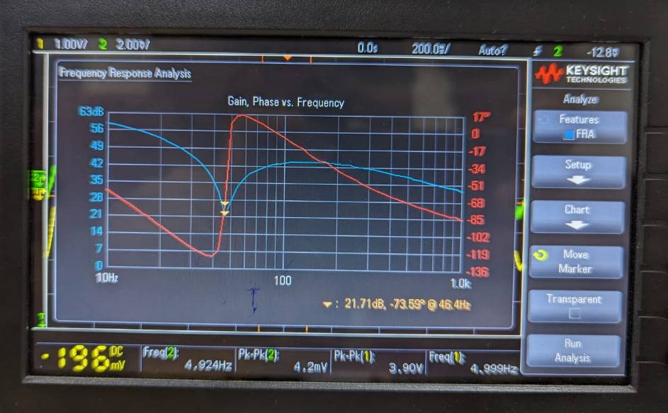
Frequency Response analysis of filters

Slide 18
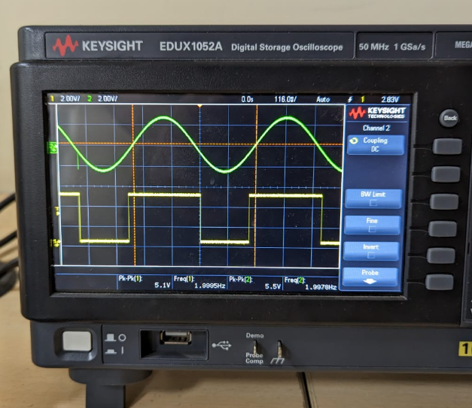
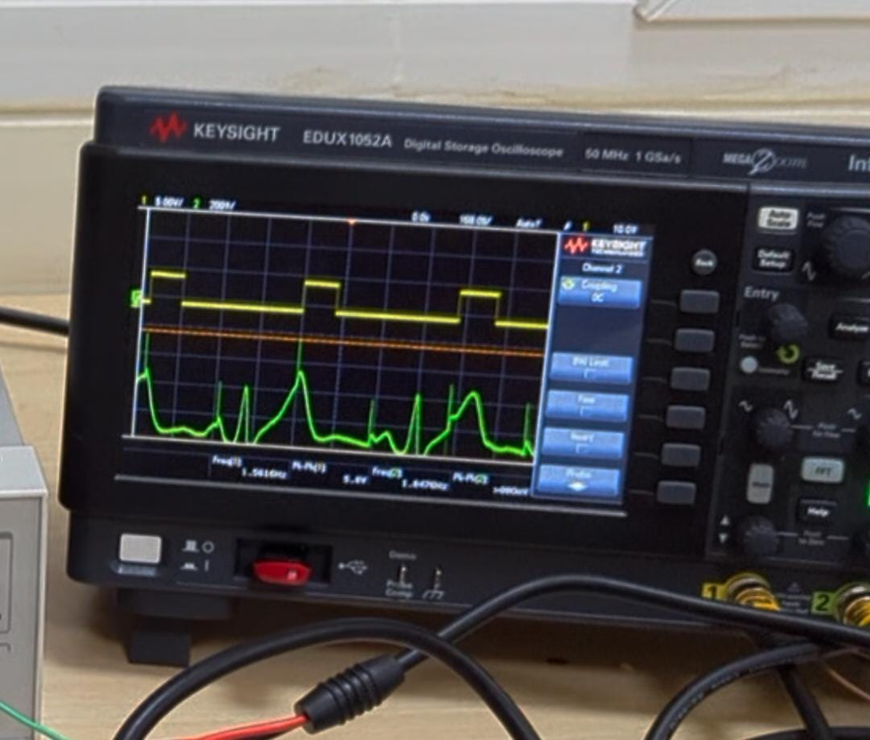
Analog to digital conversion
Sinusoid wave from waveform
ECG signal from human body

Slide 19

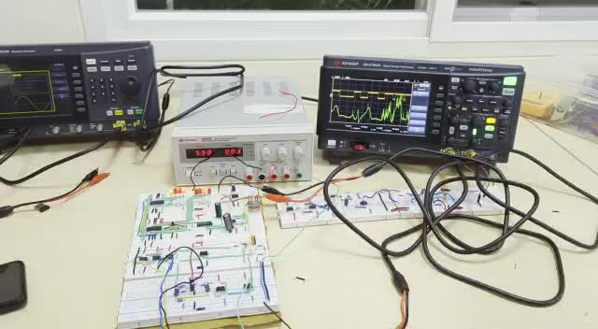

Slide 20
Challenges faced
ANALYSING THE ECG AND EXTRACTING HEART RATE WITHOUT USING MICROCONTROLLER
FORM OF DISPLAY USED TO OUTPUT THE HEARTBEAT
NOISE REDUCTION - REJECTING THE PREVELANT 50HZ NOISE
ANALOG TO DIGITAL CONVERSION, AND FIGURING OUT PULSE WIDTH OF PULSE

Slide 21
Improvements
MAKING THE CIRCUIT MORE ROBUST TO PROCESS ECG SIGNAL OF DIFFERENT AMPLITUDES
ADDING A DIGITAL DISPLAY INSTEAD OF USING LED OUTPUTS AS BINARY BITS
IMPROVING THE ECG EXTRACTION PROCESS AND USING A WAY BETTER THAN GEL ELECTRODES

Slide 22
Conclusion
WORKING ON THIS PROJECT HELPED US TO:
BETTER UNDERSTANDING AND WORKING WITH BIOPOTENTIAL SIGNALS
HOW EVERY PART OF AN ELECTRONIC CIRCUIT CONTRIBUTES TO THE WHOLE PROBLEM STATEMENT
IMPROVE OUR THINKING CAPABILITIES BY FINDING SOLUTIONS TO NEWLY ENCOUNTERED PROBLEMS AND ISSUES
Thank you

